Slide 1
Modeling Neuromorphic Devices
Structure and Dynamics of Atomic Switch Networks
Ido Marcus
October 2016

Slide 2
Neuromorphic Devices

Slide 3
Neuromorphic Devices
What
Brain-like hardware
Why
Brain implants
Paradigm to succeed CMOS chips; neural computing, supercomputers
Artificial platform for brain research
possible future applications

Slide 4
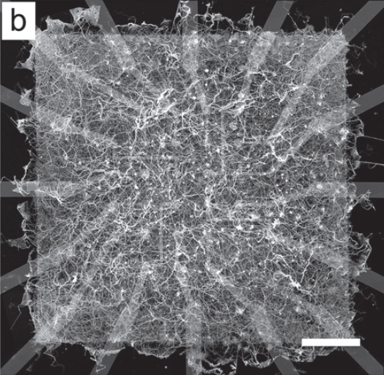
Atomic Switch Networks
Networks of self-assembled nanowires are a design scheme for neuromorphic devices
Resulting networks are densely interconnected
Devices can be probed while “working”
Demis et al., Nanotechnology (2015)

Slide 5
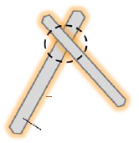
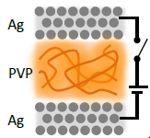
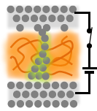
Atomic Switch Networks (cont.)
Coating
The conductive (Ag) nanowires are coated with an insulating material
Metal-Insulator-Metal (MIM) interfaces are created at wire intersections. These are “Atomic Switches”
An atomic switch turns ON\OFF upon formation\dissolution of a conductive filament that bridges over the insulating gap
The electronically insulating gap is ionically conductive, so filament dynamics are due to ion migration
Ag
OFF state
(High resistance)
ON state
(Low resistance)
Ag
Coating
Ag

Slide 6
Experimental Observations

Slide 7
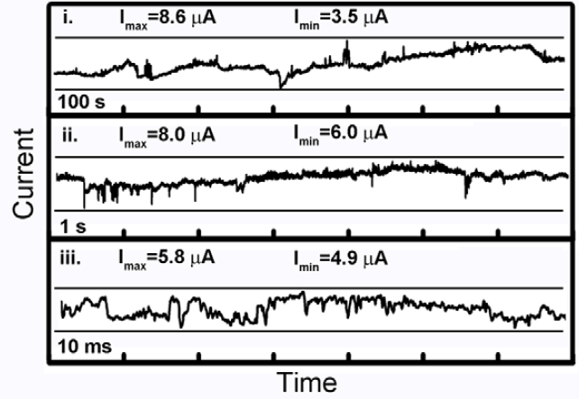
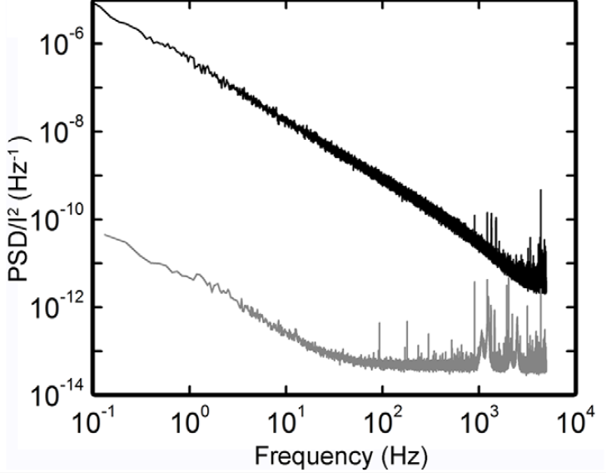
Atomic Switch Networks – Criticality and Fluctuation Scaling
ASN
Control
Avizienis et al., PLoS ONE (2012)

Slide 8
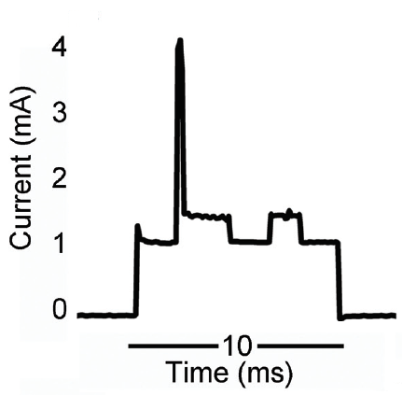
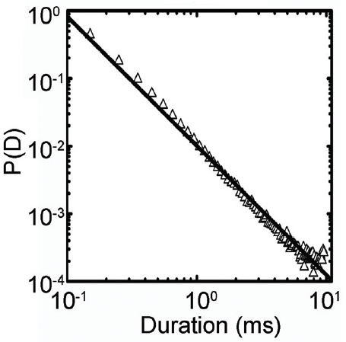
Atomic Switch Networks – Criticality and Fluctuation Scaling (cont.)
Steig et al., Advanced Materials (2012)

Slide 9
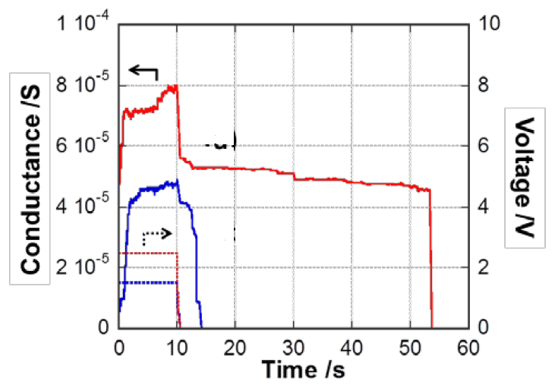
Atomic Switch Networks – Plasticity and Hysteretic Behavior
Nakayama et al., Unpublished

Slide 10
Modeling

Slide 11
Modeling - Motivation and Principles
Motivation:
Using elementary circuit theory, reproduce dynamics measured experimentally
Study the microscopic origin of the observed collective dynamics
Study the extent of similarity to brain dynamics
Simulation stages:
Network generation
Equations extraction
Time evolution
Update switches
Solve circuit

Slide 12
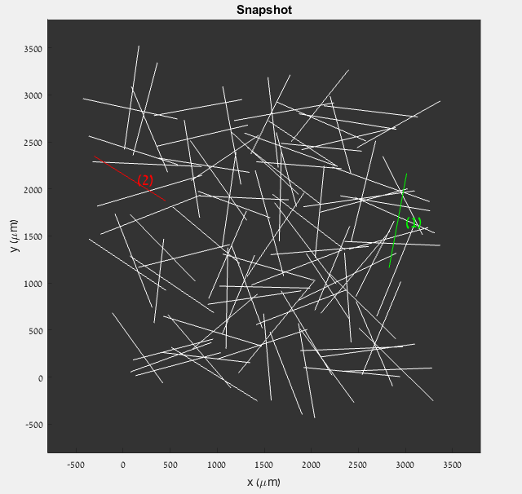
Network generation
Network generation
Equations extraction
Time evolution
Wires are scattered on a plane:
Orientations and positions are uniformly distributed
Lengths are sampled from a gamma distribution
Intersections (atomic switches) are labeled
Two wires are chosen as contacts to which a voltage bias is applied

Slide 13
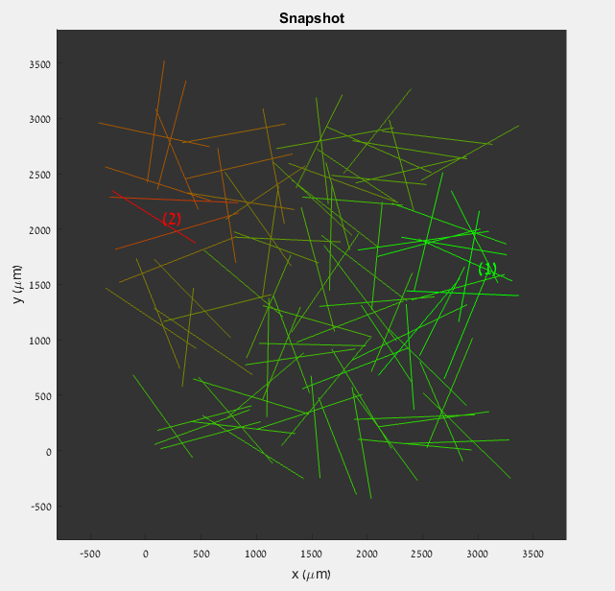
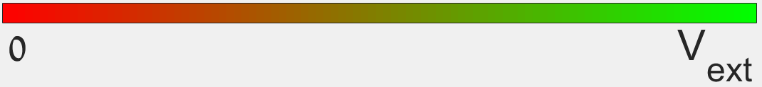
Equations extraction
Network generation
Equations extraction
Time evolution
Along each wire the potential is constant
Voltage drops occur across switches
For a given state of the switches, the voltage distribution can be found by solving Kirchhoff’s equations
Equations are obtained using a graph representation of the network

Slide 14
Graph representation
Network generation
Equations extraction
Time evolution
Notation $V$ vertices $E$ edges
Notation 𝑉 vertices 𝐸 edges
Every wire is a vertex
Every switch (=intersection) is an edge
Network structure is represented with an adjacency matrix
Graph is connected, undirected and unweighted
Atomic switch network
Equivalent graph
Graph’s adjacency matrix
4
1
4
 | 1 | 2 | 3 | 4
1 | 0 | 0 | 1 | 1
2 | 0 | 0 | 1 | 0
3 | 1 | 1 | 0 | 0
4 | 1 | 0 | 0 | 0
1
3
2
2
3

Slide 15
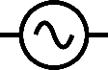
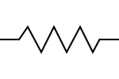
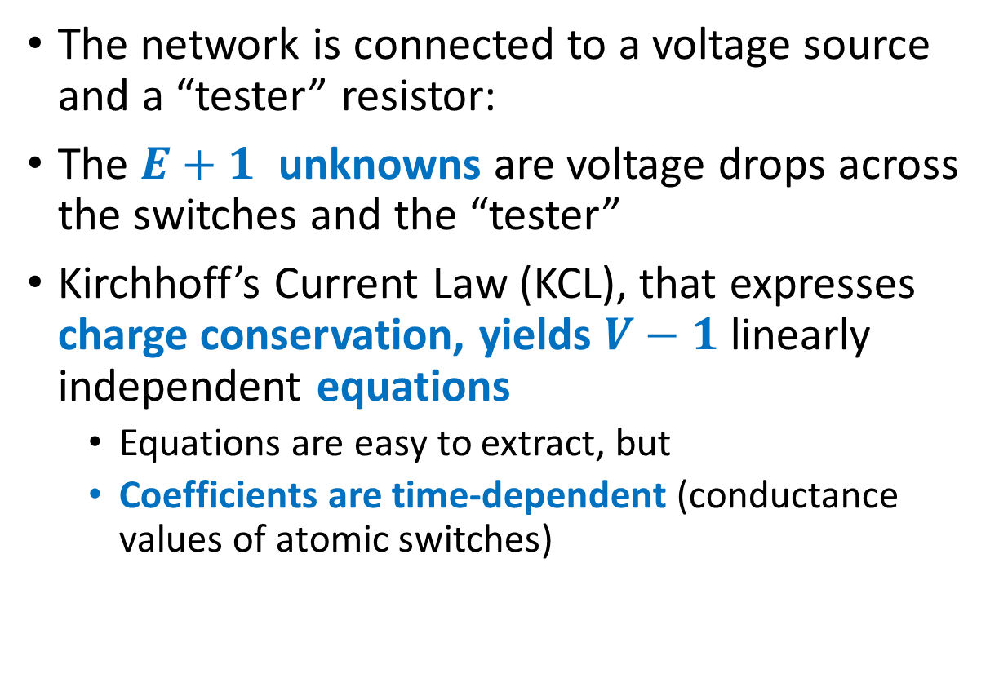
Kirchhoff’s Equations
Network generation
Equations extraction
Time evolution
Notation $V$ vertices $E$ edges
Notation 𝑉 vertices 𝐸 edges
The network is connected to a voltage source and a “tester” resistor:
The $E+1$ unknowns are voltage drops across the switches and the “tester”
Kirchhoff’s Current Law (KCL), that expresses charge conservation, yields $V−1$ linearly independent equations
Equations are easy to extract, but
Coefficients are time-dependent (conductance values of atomic switches)
external voltage
“tester“ resistor
Atomic Switch Network
contacts

Slide 16
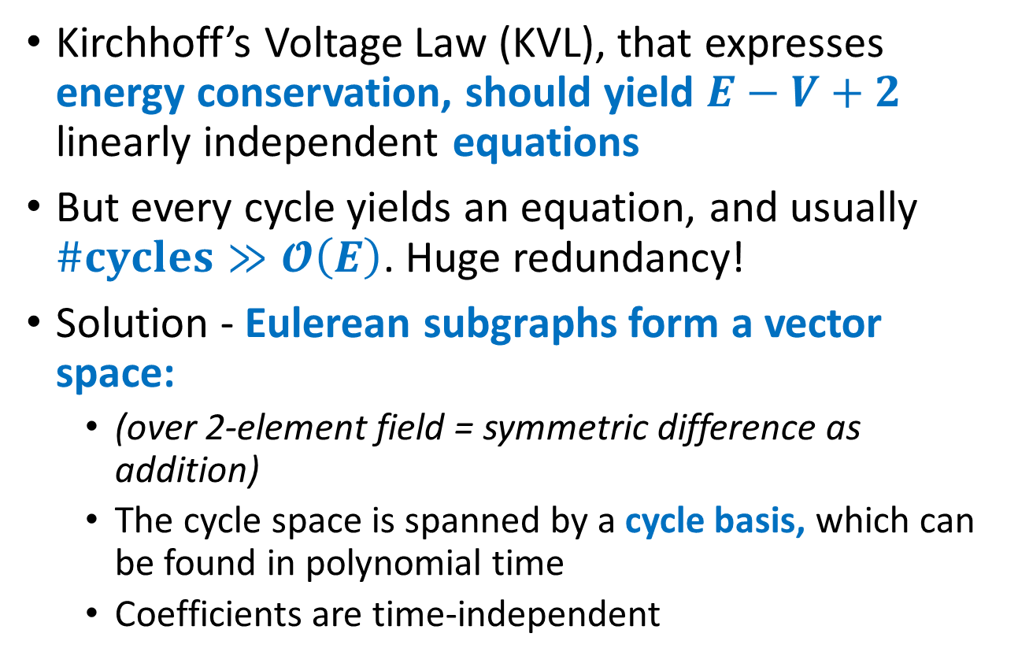
Kirchhoff’s Equations (cont.)
Network generation
Equations extraction
Time evolution
Notation $V$ vertices $E$ edges
Notation 𝑉 vertices 𝐸 edges
Kirchhoff’s Voltage Law (KVL), that expresses energy conservation, should yield $E−V+2$ linearly independent equations
But every cycle yields an equation, and usually $\#cycles≫𝓞\left(E\right)$. Huge redundancy!
Solution - Eulerean subgraphs form a vector space:
(over 2-element field = symmetric difference as addition)
The cycle space is spanned by a cycle basis, which can be found in polynomial time
Coefficients are time-independent
Notes:
A walk is an alternating sequence of vertices and edges, starting and ending at a vertex, in which each edge is adjacent in the sequence to its two endpoints.
A trail is a walk without repeated edges.
An Eulerian trail is a trail in a graph which visits every edge exactly once.
An Eulerian circuit is an Eulerian trail which starts and ends on the same vertex.
“Eulerian graph” has two common meanings. One meaning is a graph with an Eulerian circuit, and the other is a graph with every vertex of even degree. These definitions coincide for connected graphs.

Slide 17
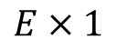
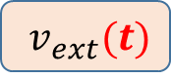
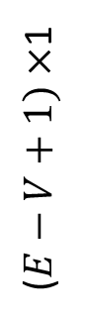
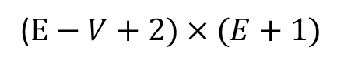
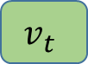
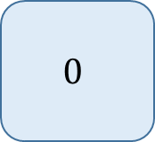
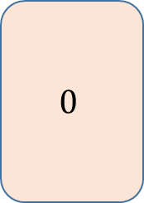
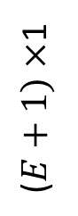
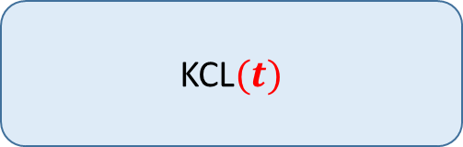
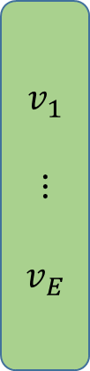

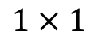
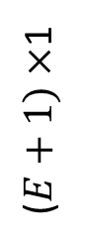
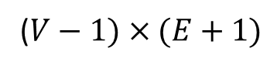
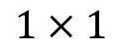
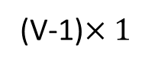
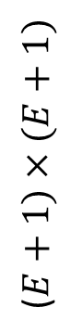
Kirchhoff’s Equations (summary)
Network generation
Equations extraction
Time evolution
Update switches
Solve circuit
($V−1)×(E+1)$
$$E×1$$
(V-1)$×1$
KCL$(t)$
$$v_{1}$$
$$⋮$$
$$v_{E}$$
$$0$$
$$=$$
KVL
$$0$$
($E+1)×(E+1)$
($E+1)×$1
($E+1)×$1
($E−V+1)×$1
ext. source cycle
$$v_{t}$$
$v_{ext}(t)$
($E−V+2)×(E+1)$
$$1×1$$
$$1×1$$

Slide 18
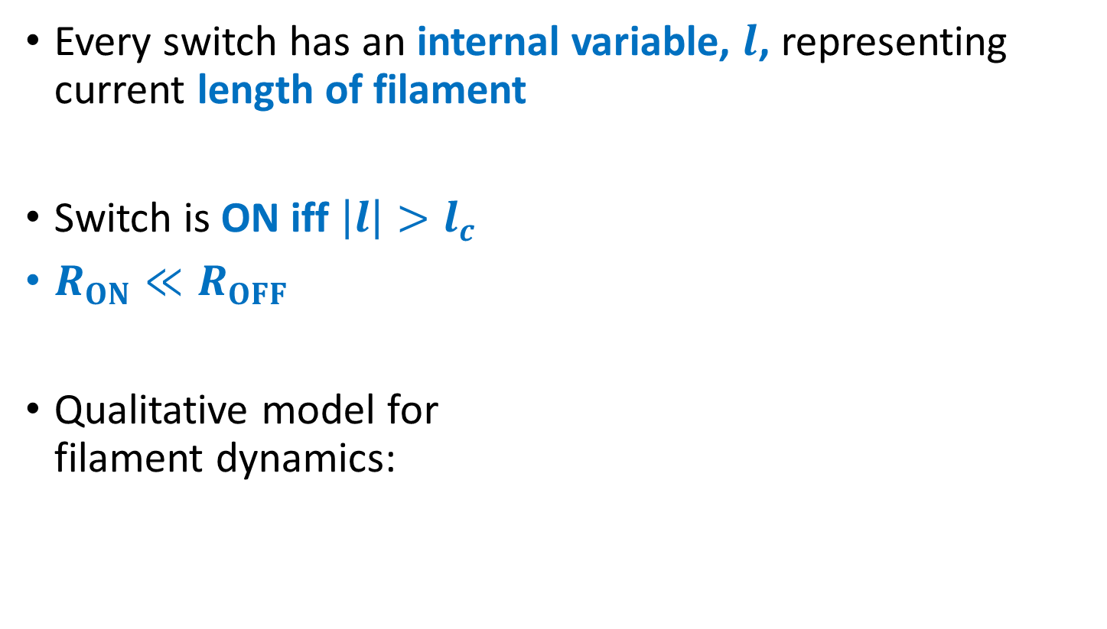
Dynamics of an individual atomic switch
Network generation
Equations extraction
Time evolution
Update switches
Solve circuit
Every switch has an internal variable, $l$, representing current length of filament
Switch is ON iff $\left|l\right|>l_{c}$
$R_{ON}≪R_{OFF}$
Qualitative model for filament dynamics:
Voltage
Filament forming
No voltage
Filament dissolving
Opposite voltage

Slide 19
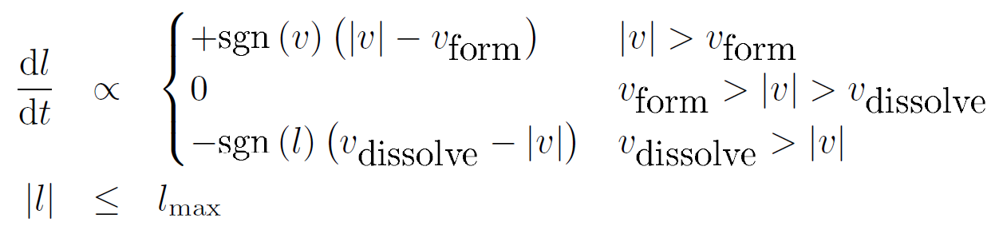
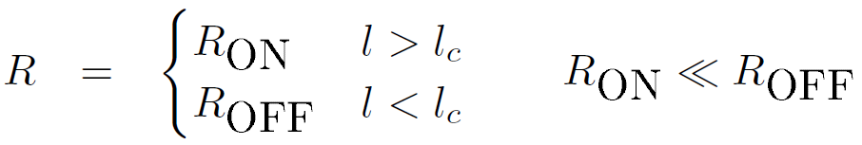
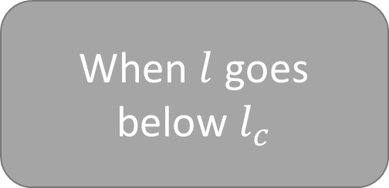
Dynamics of an individual atomic switch (cont.)
Network generation
Equations extraction
Time evolution
Update switches
Solve circuit
When $l$ goes below $l_{c}$

Slide 20
Preliminary Results

Slide 21
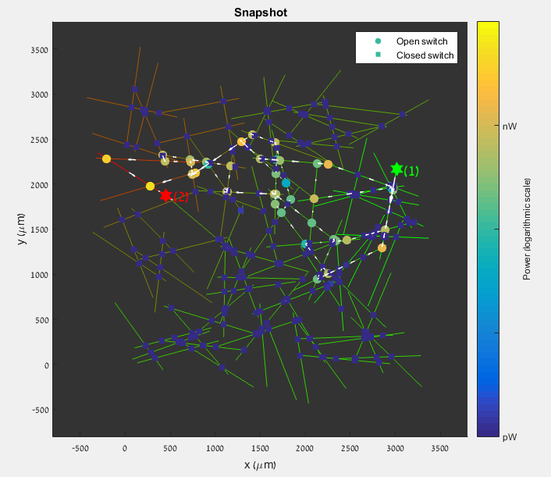
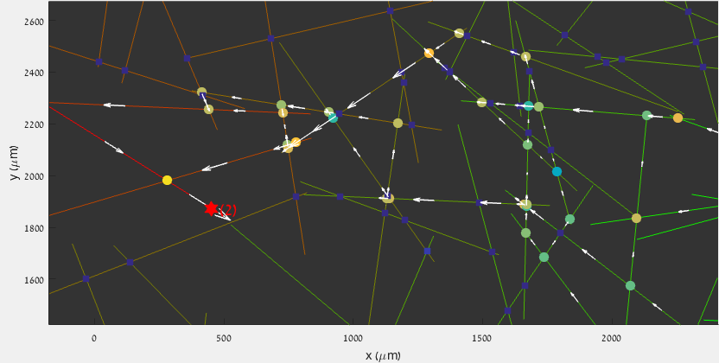
Static Solution
Voltage distribution, current paths, and dissipation can all be studied

Slide 22
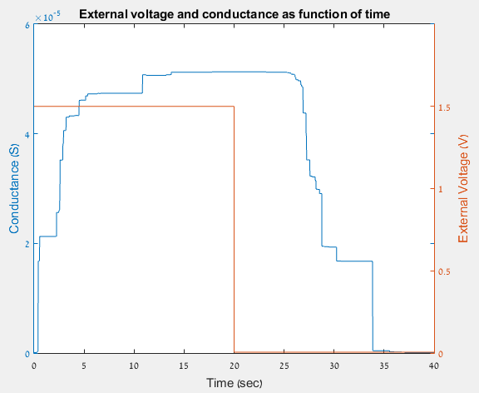
Dynamics
1
2
3
4
When the state of a switch changes, it affects the overall conductance
Switches turn ON
Switches are ON
Bias is turned off, filaments are getting weak
Switches turn OFF
Switches are OFF
Bigger changes stem from collective switching of more switches
2a

Slide 23
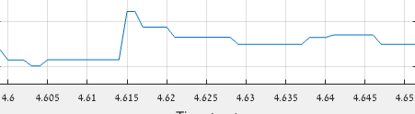
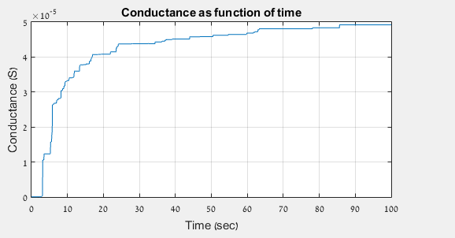
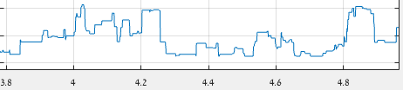
Fluctuation Scaling

Slide 24
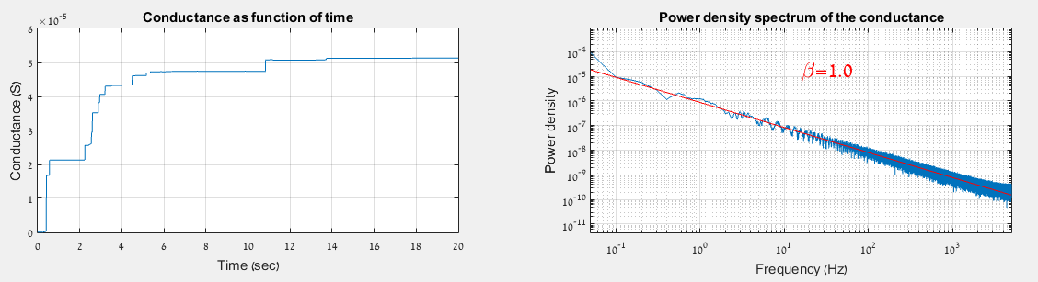
Fluctuation Scaling (cont.)
Under a DC bias, fluctuations in conductance show a 1/f noise pattern

Slide 25
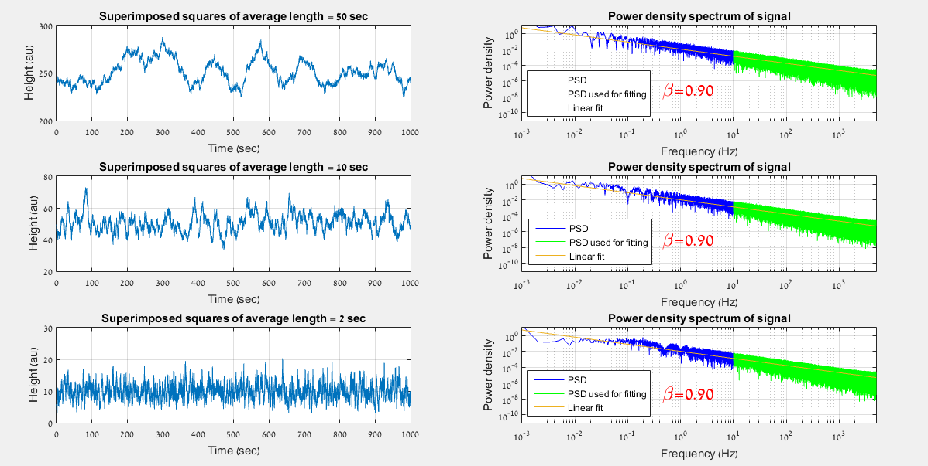
Random Squares Superimposed

Slide 26
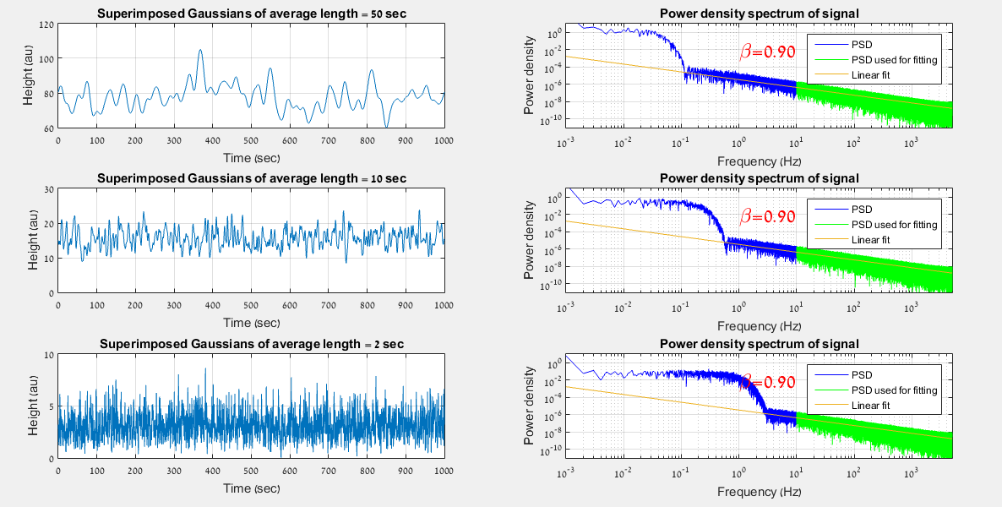
Random Gaussians Superimposed

Slide 27
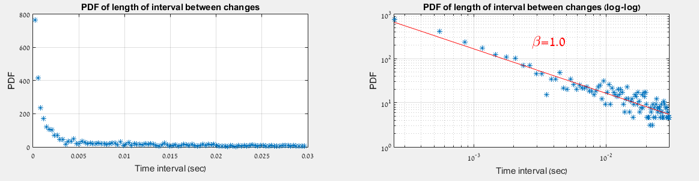
Fluctuation Scaling (cont.)
There is no characteristic time-scale for changes in the conductance

Slide 28
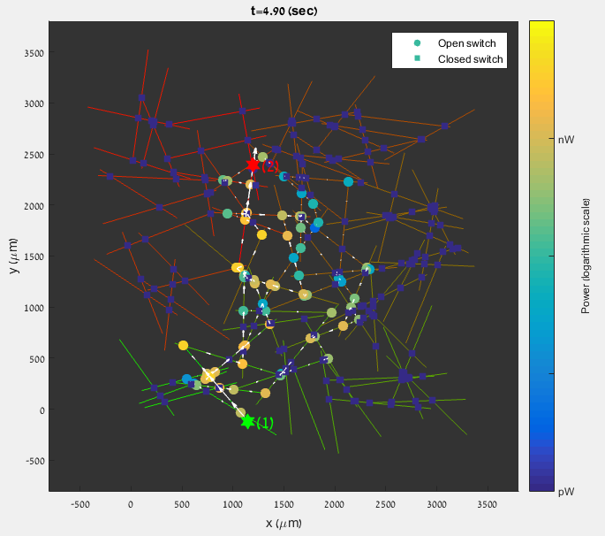
Clusters
Over time two clusters of switches are distinguished:
A cluster with a majority of ON switches is formed between the contacts
The other, with a majority of OFF switches, is “avoided” by the current
This process can be best seen in a movie

Slide 29
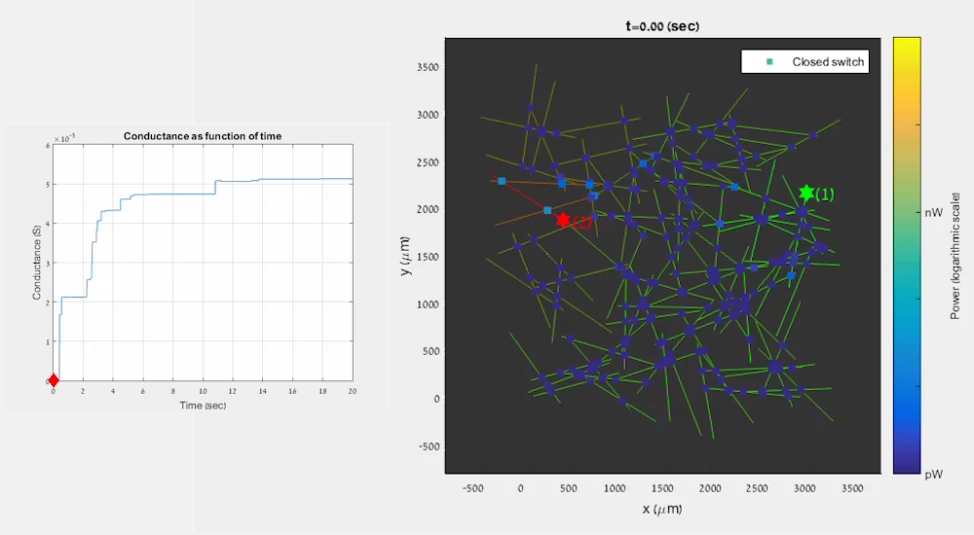

Formation of conductive paths
Conductance as func. of time
Power (logarithmic scale)
Conductance (S)
Time (sec)

Slide 30
Conclusion
Elementary circuit analysis was combined with voltage-dependent dynamics of atomic switches
Overall behavior that had been experimentally observed was reproduced
Time-dependent conductance
Hysteresis
Underlying microscopic picture was elucidated
Formation of conductive paths
Clusters as emergent spatial pattern
Fluctuations are consistent with criticality

Slide 31
Leads for Further Research
Origins of 1/f noise pattern:
Different exponents for different states of the network (ON\OFF)?
Phase transition - first path of ON switches:
Timing as function of difference from critical voltage
Signal auto-corrolation as function of time
Big networks:
Recurring spatiotemporal patterns
Modeling other systems (economics)

Slide 32
Questions?
Thank you!

